Slide 1
District 28 Superintendent’s Report
November 3, 2022

Slide 2
Vision In Community School District 28 we celebrate our differences because we understand that they offer us unlimited possibility to learn and expand our knowledge of and commitment to all humanity. We are beautifully diverse, coming from countless racial, ethnic, language, and belief backgrounds. We commit to striving for inestimable contribution to the lives of our scholars. Mission In Community School District 28 we focus on equity as a lever for achievement for every single scholar. We are a district of excellence. We commit to every school maintaining high academic standards. We commit to being a district of learners ensuring that we promote critical thinking rooted in core content conceptual understanding through creative problem solving, technology innovation, social emotional learning, and community advocacy.

Slide 3
District Team Structure

Slide 4
What Has Your District Accomplished
All Of Our Schools Are Implementing District-Wide Focus (Discussion Protocol).
MWBE Initiative (Partnering with Charles Fisher and Daymon John (Shark Tank)
Think Tank Initiative / Partnership (Elected Officials, MBK, Microsoft, & Malik Yoba)
Principal Collaborative Working Groups in partnership with 21st Century Ed and Educate Professional Learning Series
Program Service Linkage D28 is ranking #2 Citywide and ranking # 1 Queens South
Citywide Proficiency Ranking ELA # 9 and Math #10
Queens Proficiency Ranking ELA #4 and Math #2
Magnet grant winner totaling 14.9 million dollars (MS 72, MS 332, PS 182, PS 312)

Slide 5
2021-22 Demographic Snapshot for District 28
Citywide Total Enrollment: 20,811
Change in Enrollment: -1.0%

Slide 6
Teacher Data
District 28 scholars are served by 1,695 teachers.
35% of our teachers are people of color and 83% of our scholars are also people of color.
5% of our teachers have fewer than 2 years' experience.

Slide 7
District 28 Attendance Rate by Subgroup

Slide 8
District 28 Chronic Absenteeism Rate by Subgroup
Chronic Absenteeism: Percentage of students who are absent 10% or more instructional days

Slide 9
Program Service Linkage Summary as of 11/17/22
B/CO | TOTAL MANDATES | TOTAL MANDATES FULLY MATCHED | % OF MANDATES FULLY MATCHED
Access | 22019 | 14490 | 66%
Bronx | 112391 | 96185 | 86%
Brooklyn North | 59942 | 53123 | 89%
Brooklyn South | 68207 | 62447 | 92%
D75 | 104032 | 90152 | 87%
Manhattan | 70420 | 60893 | 86%
Queens North | 68343 | 62562 | 92%
Queens South | 46713 | 42645 | 94%
Staten Island | 38053 | 34379 | 90%
Notes:
8% of not fully matched yet may be due to re-evaluations with IEPs and teachers with specific language that is difficult to recruit however, paraprofessionals with the language is attached to support student learning.

Slide 10
Program Service Linkage Queens South by District as of 11/03/22
SUPERINTENDENT | TOTAL MANDATES | TOTAL MANDATES FULLY MATCHED | % OF MANDATES FULLY MATCHED
BONDS, CRYSTAL | 8707 | 8039 | 92%
NORMENT, DAVID | 15161 | 13559 | 89%
PATE, TAMMY | 9540 | 8974 | 94%
Notes:
Leading Queens South in the program service linkage and number 2 ranking in the city.
6% maybe due to re-evaluation of IEPs and language specific recommendations for teachers who are difficult to recruit which is an overall city issues.

Slide 11
Elementary/Middle School Accountability Measures

Slide 12
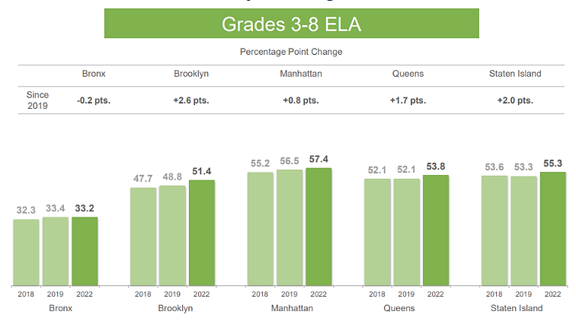
Proficiency Rates for NYC Students in ELA by Borough

Slide 13
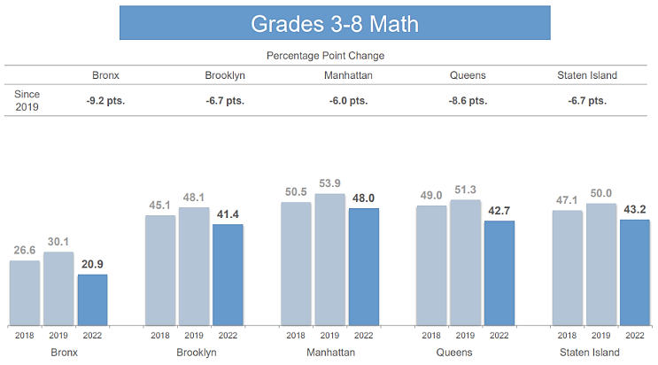
Proficiency Rates for NYC Students in Math by Borough

Slide 14
District 28 Proficiency Level Results on the NYS 2021-22 ELA Exam
Notes:
updated

Slide 15
NYS 2021-22 ELA Exam: Performance Across Standards
Notes:
District focus on DISCUSSION PROTOCOLS
More exposure to Tier 2 & 3 academic language
ILT Inquiry

Slide 16
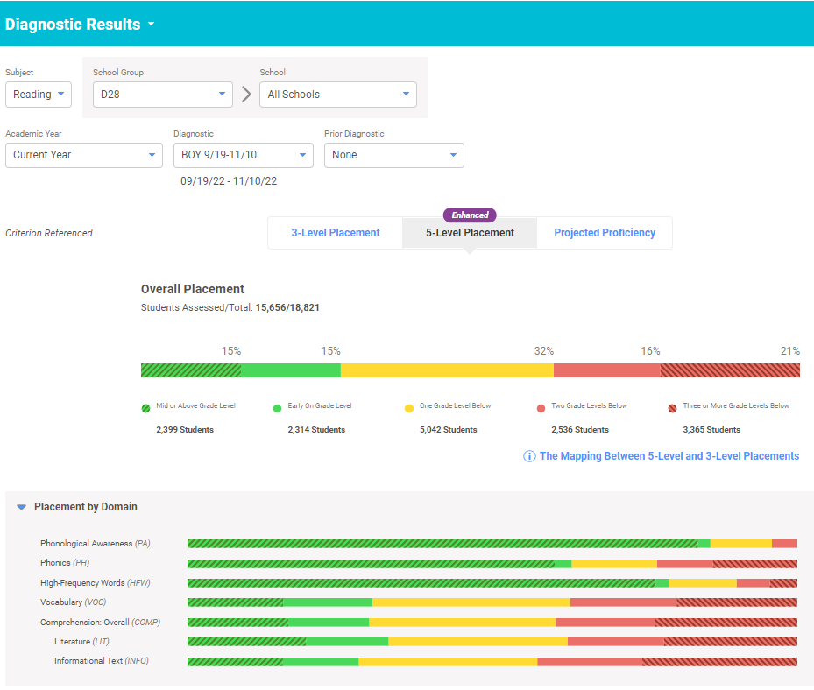
iReady English Language Arts Screener

Slide 17
Acadience Proficiency: K-2 Literacy Spotlight
Our Early Literacy data demonstrates a sound start for our scholars.
Acadience reading results at both the overall/“composite” score level and at the individual component/“measure” level. Note that individual “measures” vary by grade. Districtwide and citywide results are also included for reference. The Acadience reading measures for K-2 included in this workbook are:
Phoneme Segmentation Fluency (PSF): PSF assesses the student’s fluency in segmenting a spoken word into its component parts or sound segments.
Nonsense Word Fluency (NWF): NWF assesses knowledge of basic letter-sound correspondences and the ability to blend letter sounds into consonant vowel-consonant (CVC) and vowel-consonant (VC) words.
Oral Reading Fluency (ORF): ORF is a measure of advanced phonics and word attack skills, accurate and fluent reading of connected text, and reading comprehension.
District | School DBN | Grade | # of Students | Composite | Phoneme Segmentation Fluency | NWF Correct Letter Sounds | NWF Whole Words Read | ORF Accuracy | ORF Words Correct | ORF Retell
Citywide | Citywide | K | 53864 | 42.40% | 38.20% | 49.70%
Citywide | Citywide | 1 | 54441 | 49.20% |  | 39.30% | 49.00% | 53.30% | 48.20% | 63.60%
Citywide | Citywide | 2 | 54861 | 52.30% |  |  |  | 58.50% | 48.50% | 57.20%
CS28 | CS28 | K | 2366 | 49.60% | 44.80% | 57.70%
CS28 | CS28 | 1 | 2303 | 57.50% |  | 46.70% | 55.30% | 61.10% | 57.00% | 67.80%
CS28 | CS28 | 2 | 2392 | 60.70% |  |  |  | 67.40% | 57.30% | 62.20%

Slide 18
District 28 Proficiency Level Results on the NYS 2021-22 Math Exam
Notes:
updated

Slide 19
NYS 2021-22 Math Exam: Performance Across Standards
Notes:
Spiral of geometry standards beginning earlier in the year
Exposing of math concepts from early childhood to build stronger skill
ILT Inquiry

Slide 20
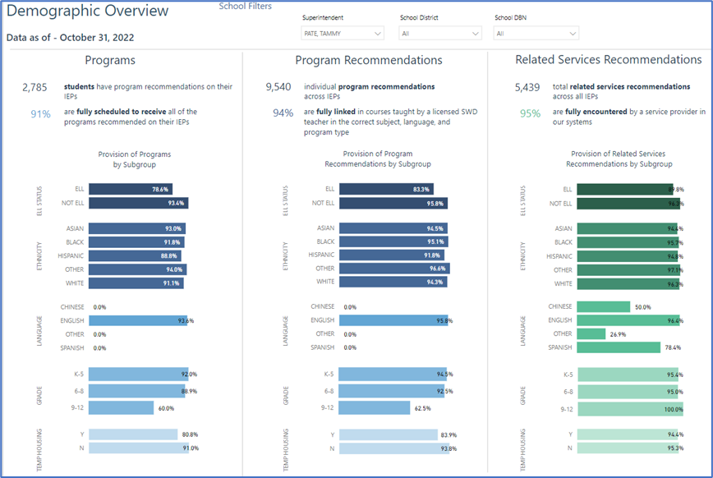
Our Students with IEPs Data
Notes:
This slide shows the various IEP classifications in our district. The most common classification is Speech or Language Impaired, followed by Learning Disability.
CSP – Comparable Service Plan. This is created for students with an out of state IEP in order for them to receive their services.
The next box (right side) indicates the demographic overview of our student population. 91% of students are receiving their program recommendations. 94% are fully linked with a licensed SE teacher in the correct subject, language and program type. 6% may be due to language issues or awaiting program. 95% are receiving their related service recommendations. 5% may be due to lack of providers with specific language requirements.

Slide 21
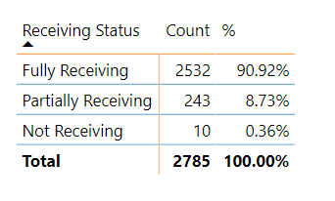
Student Receiving Status – as of October 31, 2022
Notes:
D28 currently exceeds the city which is at 79.92%. We are at 91% of students fully receiving their services. 8.73% of students are partially receiving their services and .36% are not receiving any services. There are always changes to IEPs and this may not have been updated as yet; errors in programming; lack of certified SE teachers or lack of bilingual classes.

Slide 22
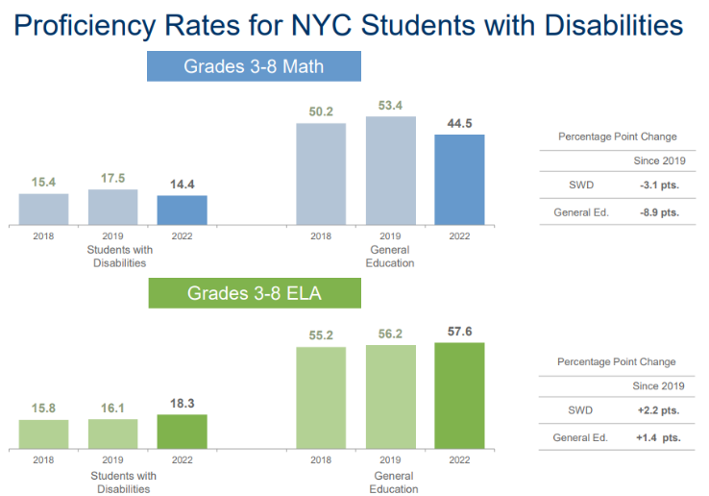
SWI Performance Across Three Years Testing

Slide 23
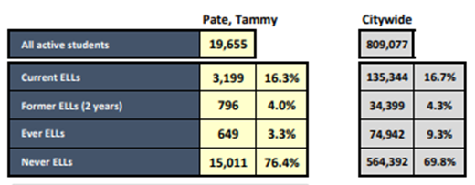
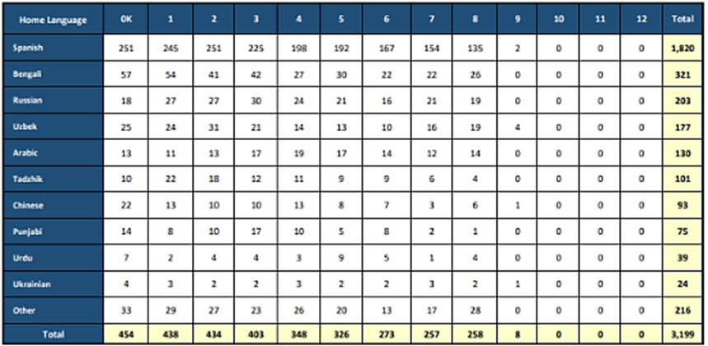
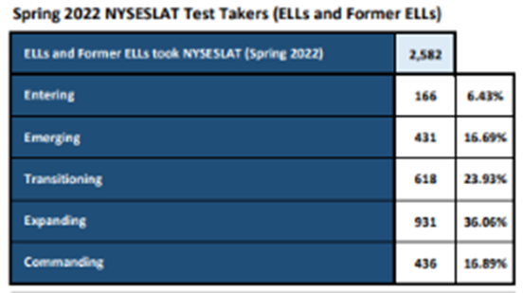
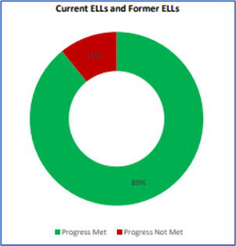
MLL Progress Rate Goals
We are working hard to ensure every student in this district makes progress against their goals.
This table summarizes current ELLs at your school by top home languages and grade level. The purpose is to identify potential areas of need for additional home language supports for students.
Below is a summary of Multilingual Learners and English Language Learners (MLs/ELLs) as a proportion of total students at your school by subgroups such as years of ELL service, and other indicators. The purpose of this page is to provide an overview of the school’s ML/ELL population
This is a summary of students’ Spring 2022 NYSESLAT results and English language proficiency progress. The purpose is to understand student growth in English language proficiency and a school’s annual federal and state accountability metrics for ELLs. Students that meet annual expected progress are on track to exit ELL services.

Slide 24
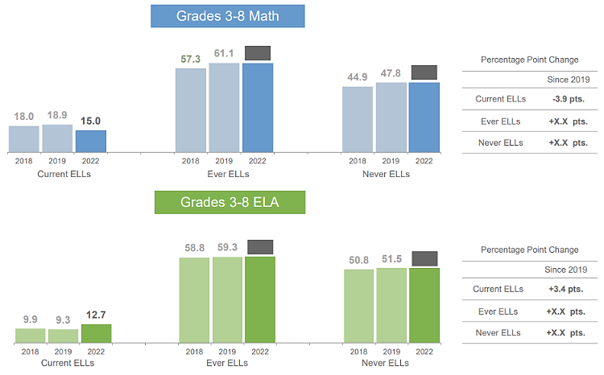
MLL Performance Across Three Years of Testing

Slide 25
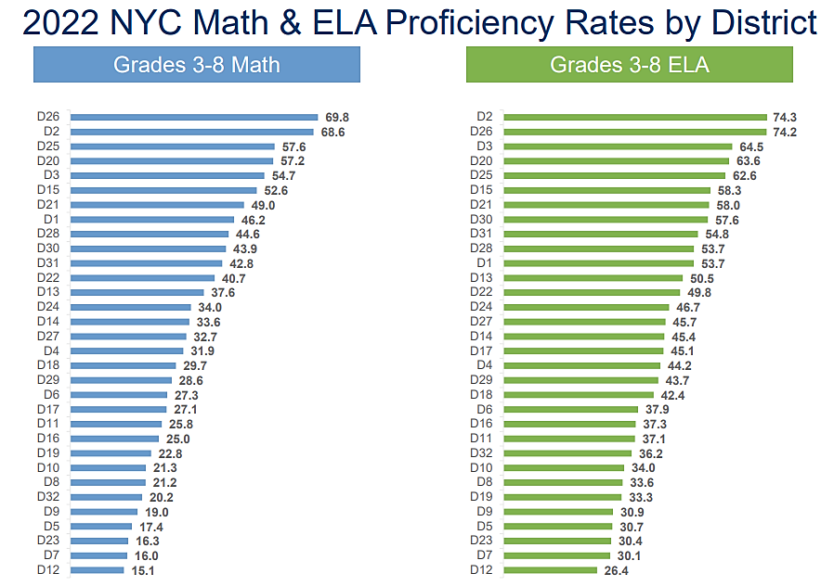
2022 NYC Math & ELA Proficiency Rates by District
Notes:
In Queens District, D28 is ranking 3rd in Math and 4th in ELA

Slide 26
Connecting our Data to our Priorities

Slide 27
District Priorities

Slide 28
District Priorities
STEAM – Our math data, as was the citywide data, experienced a dip.
MLLs (Multilingual Learners) - Our Multilingual Learners' achievement data have lagged behind some of their English-speaking peers for too long.
To ensure our scholars have the knowledge and skills to participate and lead in the 21st century, we are partnering with organizations to bring to our schools innovative experiences in STEAM (science, technology, engineering, art and mathematics)
We have committed to supporting the teachers of ELLs with shoulder-to shoulder coaching, additional opportunities for Professional Development and have instituted a district-wide book study on encouraging student discussion.

Slide 29
District Priorities
Students with IEPs - As with our ELL achievement data, although increased, our SWI's achievement data have lagged behind some of their peers.
Improved Literacy Practices – although our district-wide
We have committed to supporting the teachers of SWIs with shoulder-to shoulder coaching, additional opportunities for Professional Development, clinics and are looking to partner with the Central office to offer additional bilingual special education classes to serve some of our most vulnerable SWIs.
We have developed district goals that specifically address the achievement data for our district. These include but are not limited to ensuring high expectations and rigorous instruction for every single student grounded in an asset-based mindset, strengthening a welcoming environment, implementing an inclusive curricula and centering time for ongoing and targeted PL communities.

Slide 30
District Priorities
Equity – Whether we examine closely Citywide data or district-wide, there is always one constant: when disaggregated, our most vulnerable students' data show the greatest needs.
MWBE (Minority Women-owned Business Entreprises) - MWBE and Employment Fairs
To address this fact and dismantle it as such in D28, we are partnering with divisions, community and governmental organizations, to support all of our scholars whatever their needs: SEL support, migrant student resources, partnership with SPACE to develop leaders to analyze data through the lens of equity and address those inequities head on and pursuing funding to support this work.
Our work with our scholars doesn't stop within the 4 walls of the school building. We are very much aware that the socio-economic struggles of parents are linked to the opportunities or lack thereof afforded to their children. To uplift our scholars, we need to uplift the community from which they come, and thus provide families, businesses and potential entrepreneurs, the opportunities to interact in different ways with the DOE, to provide services that they sometimes only can and to thrive and thus stay in D28.

Slide 31
Lattice of Support
Explain what it is and the mode of support (from our handbook)

Slide 32
2022-2023 Lattice of Support
Individualized thought partnerships and support
Notes:
Working collaboratively to achieve school level outcomes.
Individualized support

Slide 33
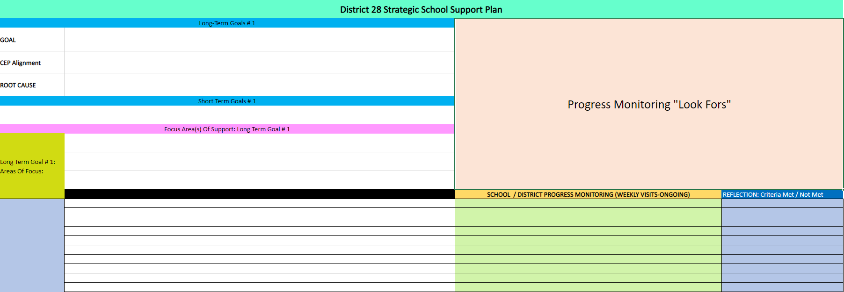
2022-2023 Strategic Leadership Support
Notes:
This IS OUR SCHOOL IMPROVEMENT PLAN...STRATEGIC LEADERSHIP SUPPORT.
We are doing 10 schools this year....Leaders agree it is positive and impactful.

